Slide 1
ZOHO CREATOR
Pet Rescue, Rehabilitation and Shelter Management System
CB23F35 – Low-Code Application Development
Kaaviya Sri PS · 240701222
Rajalakshmi Engineering College
Notes:
Introduce the problem in one line: rescue groups run on notebooks and chats. This app follows an animal from rescue to a cage or foster home. Mention the three modules: rescue, rehabilitation, shelter management.

Slide 2
From scattered notes to one system
The app proposes:
1
Rescue
2
Rehabilitation
3
Shelter
BEFORE
BEFORE
BEFORE
Rescues and injuries noted in notebooks and chats
Treatments remembered; fosters arranged by phone
Nobody knows which cages are free
NOW
NOW
NOW
Structured report, photo, injury log and instant vet alerts
Scheduled treatments, daily reminders, validated fosters
Cages recounted automatically; full cages refused
Notes:
Walk across the three cards: what was wrong before and what the app does now.

Slide 3
Seven linked forms, six roles
Forms and Records
Rescue
Injury Record
Treatment Log
Rescue Report · Injury Record
Rescue Report
Rehabilitation
Treatment Log · Foster Master · Foster Placement
Holding + Cage
Foster Placement
Shelter
Cage Master · Holding Assignment
Roles: Shelter Admin · Veterinarian · Coordinator · Caretaker · Foster Carer · Volunteer
Notes:
Every injury, treatment, cage assignment and foster placement points back to one animal record through lookups.

Slide 4
Deluge keeps the shelter correct
Scope and Occupancy
12
2
3
1
form workflows
schedules
Deluge functions
(wireflows)
approval
Rescue logged
Triage + vet alert
Treatment + reminder
Cage / foster checks
Release approval
Occupancy = count of open assignments, recounted after every move, so it never drifts. A full or unavailable cage cancels the submit with an alert.
Notes:
Key idea: recount instead of incrementing. Mention the daily 8 AM treatment digest and 9 AM capacity alert.

Slide 5
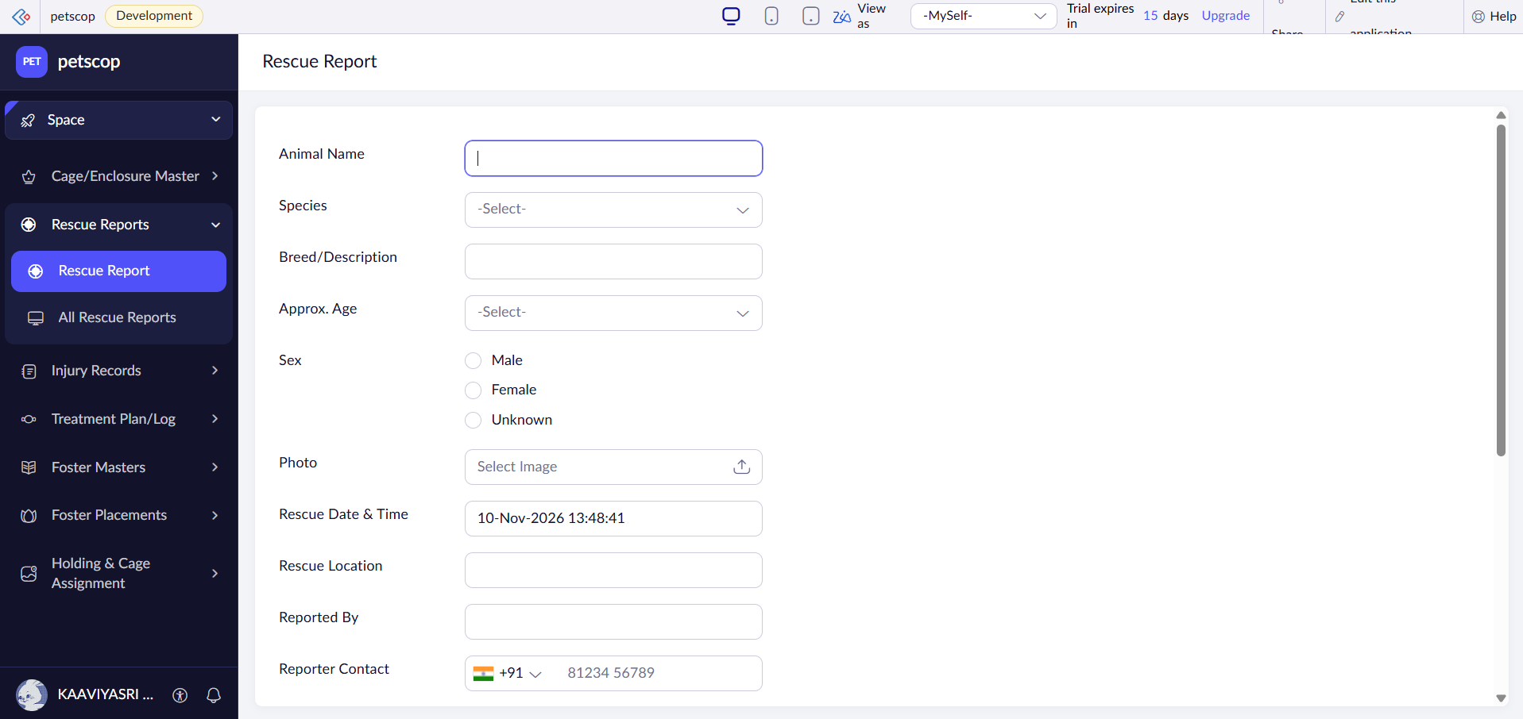
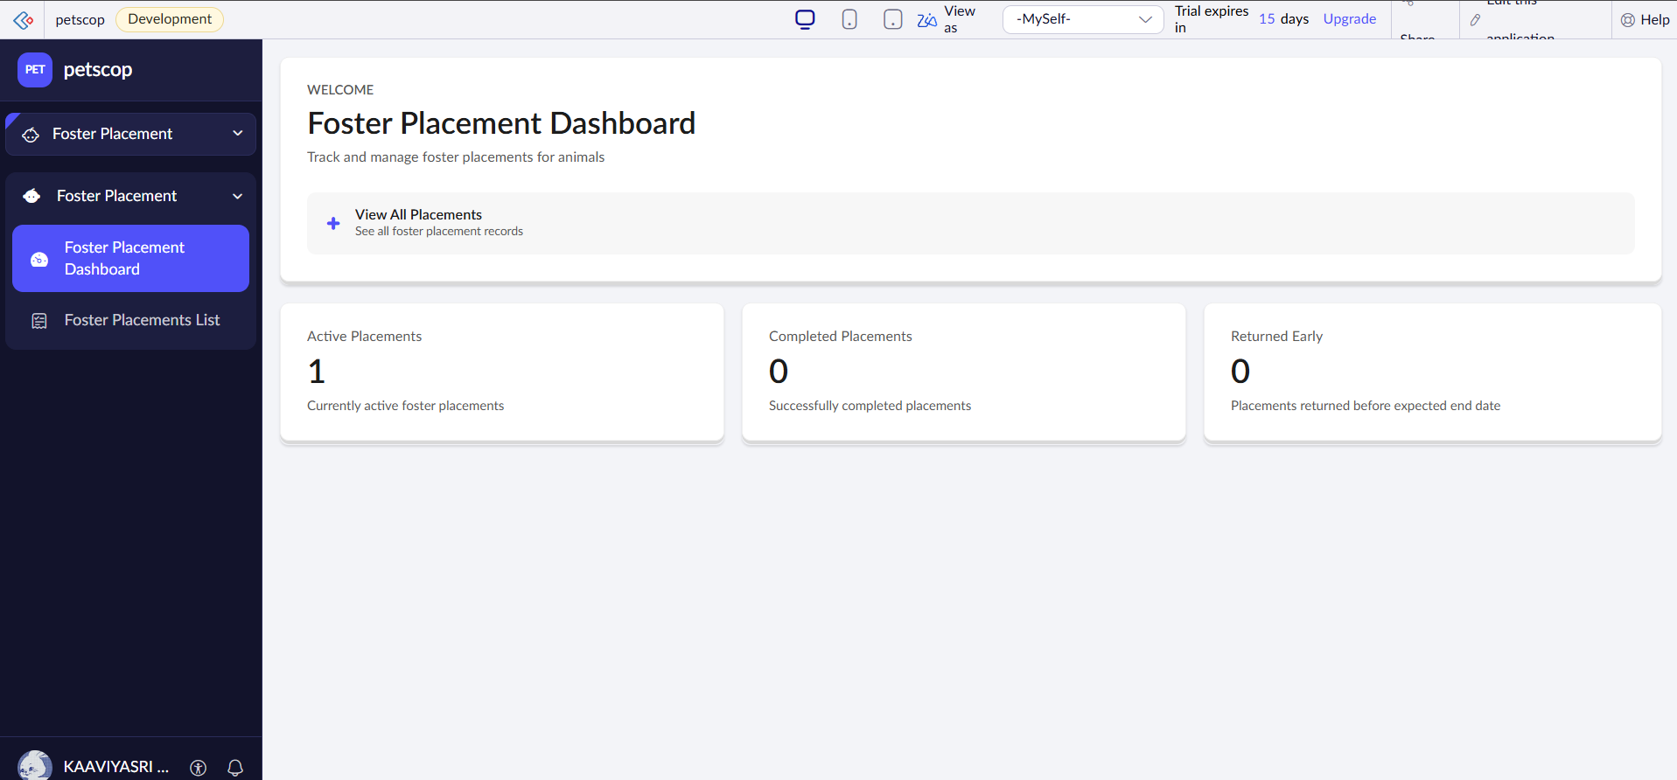
Live demo
Working System
1
Report a critical rescue (mobile)
2
Log injury and treatment
3
Assign a cage, then try a full one
Screenshot: Shelter Dashboard
4
Place the animal with a foster
5
Dashboard and foster carer view
Notes:
Switch to the live app here. Use separate browser profiles for coordinator and foster carer logins. Keep a spare full cage ready to show the validation alert.

Slide 6
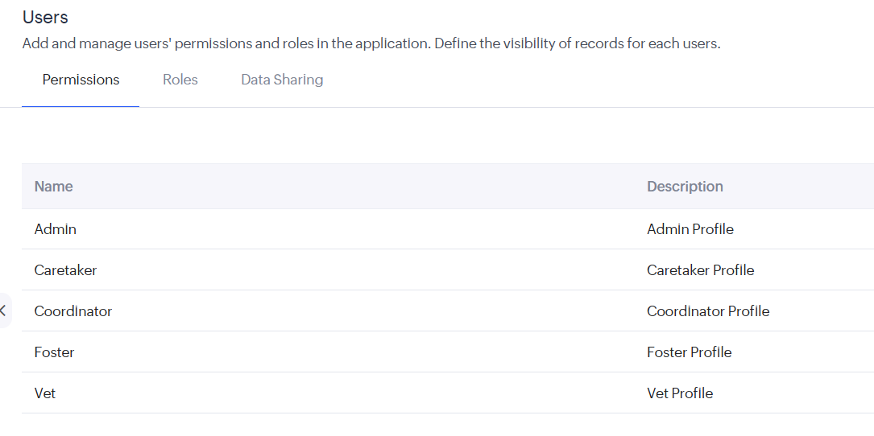
Everyone sees only what they need
User Roles and Permissions
Role | Access
Admin | Everything; approves releases
Veterinarian | Injuries, treatments, medical notes
Coordinator | Rescues, cages, fosters
Caretaker | Daily care, cage moves
Foster Carer | Own animals only
Volunteer | Report rescues; no medical fields
Record criteria for fosters: Foster_Email == zoho.loginuserid
Notes:
Mention field permissions hiding dosage and vet notes from volunteers, and script-set fields being read-only.

Slide 7
Outcomes and next steps
Summary and Future Scope
What it delivers
Next steps
No over-filled cages
No missed treatments
Fosters validated before placement
Live view of the whole shelter
Blueprint for the care pathway
Cage-map widget
Foster carer portal
Link to the adoption app
Notes:
Close with the three outcomes, then take questions.

